Slide 1

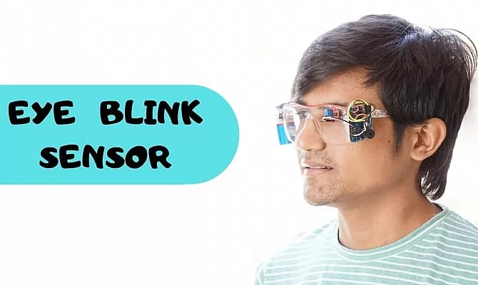
Arduino based Accident prevention system using Eye blink sensor
MICRO PROJECT
Done by Batch – 3
B. Mahesh – 20R21A0566
B. Madhavi - 20R21A0567
D. Rithvik – 20R21A0571
G. Srihitha - 20R21A0574

Slide 2
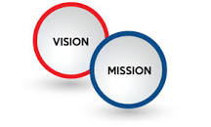
AIM : To prepare Arduino based Accident prevention system using Eye blink sensor.
VISION : To reduce the number of deaths caused by the accidents.
MISSION : Developing a system which keeps the vehicles safe and secure through critical activity.

Slide 3
ABSTRACT
This paper aims to create a framework to keep the humans safe and secure through critical activity. When we run in an ignorance we cannot take care of our own. If we make all vehicles with an automatic safety system that gives the driver a high level of protection, an alarm will also be issued.
The device has an installed a eye blink sensor. Once the driver has started feeling the drowsiness, the sensors automatically detect the blink of an eye. The blink of an eye is calculated by IR sensor. On this device the output of the sensor is provided through Buzzer connected to ARDUINO. And finally the Buzzer gives an alarm sound.

Slide 4
EXISTING SYSTEM
Drowsiness is main thing to simulate whether the accident happened due to the driver asleep. Each and every second number of accidents happened due to driver drowsiness/speed of the vehicle. Drowsiness detection system can identified through non-intrusive machines and the kit having camera that was fixed to record your head movements to detect the asleep. When the vehicle met with any accident the sensor will detect the vibration depending upon the crashes. Then the vibration will sends to microcontroller/ chip to find the location of the accident. The main purpose of the chip is used to find the latitude and longitude of the accident by using GPS. GPS will helps to send an alert message to the ambulance which is located nearest to the accident. The ambulance immediately finds the location by using Google Maps and rescues the accident

Slide 5
PROPOSED SYSTEM
Arduino based Accident prevention system using Eye blink sensor aims to create a framework to keep the car safe and examines the detection of various collisions and reduction of such a system.
The device has an installed a eye blink sensor. If the driver keep the spectacles when he is driving then the IR sensor detects whether the person is closing his eyes if the person is closing his eyes then the Buzzer sound occurs to alert the person.

Slide 6
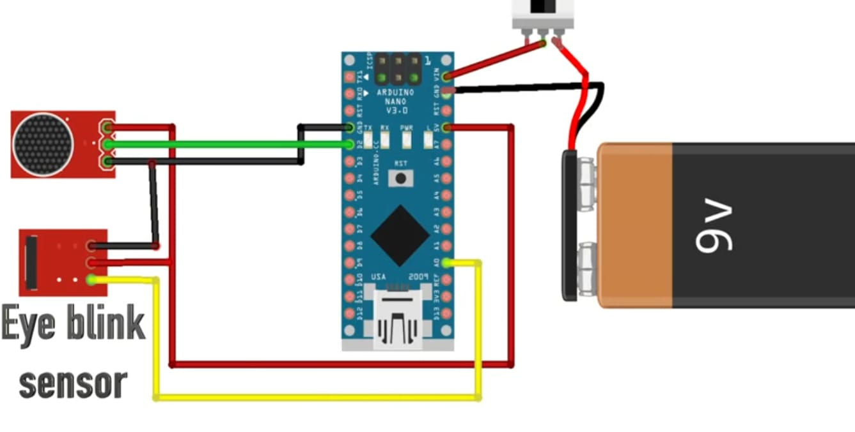
components
HARDWARE SOFTWARE
1. IR Sensor 1.ARDUINO IDE
2. Arduino Nano
3. Connecting wires
4. Buzzer
5.Jumper wire
6. 9v battery,
7. Cap
8. Switch

Slide 7
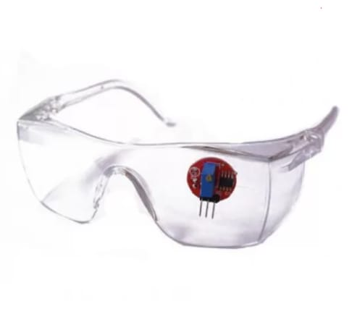
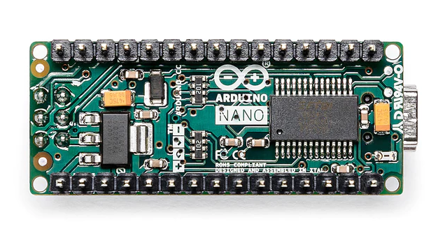
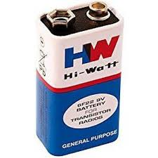
IR Sensor : It illuminates the eye with infrared light and monitors the changes in the reflected light.
Arduino NANO: Arduino boards are able to Read inouts – light on a sensor, a finger on a button and turn it into an output.
9V Battery : Battery is used to give power to the DC Motor.

Slide 8
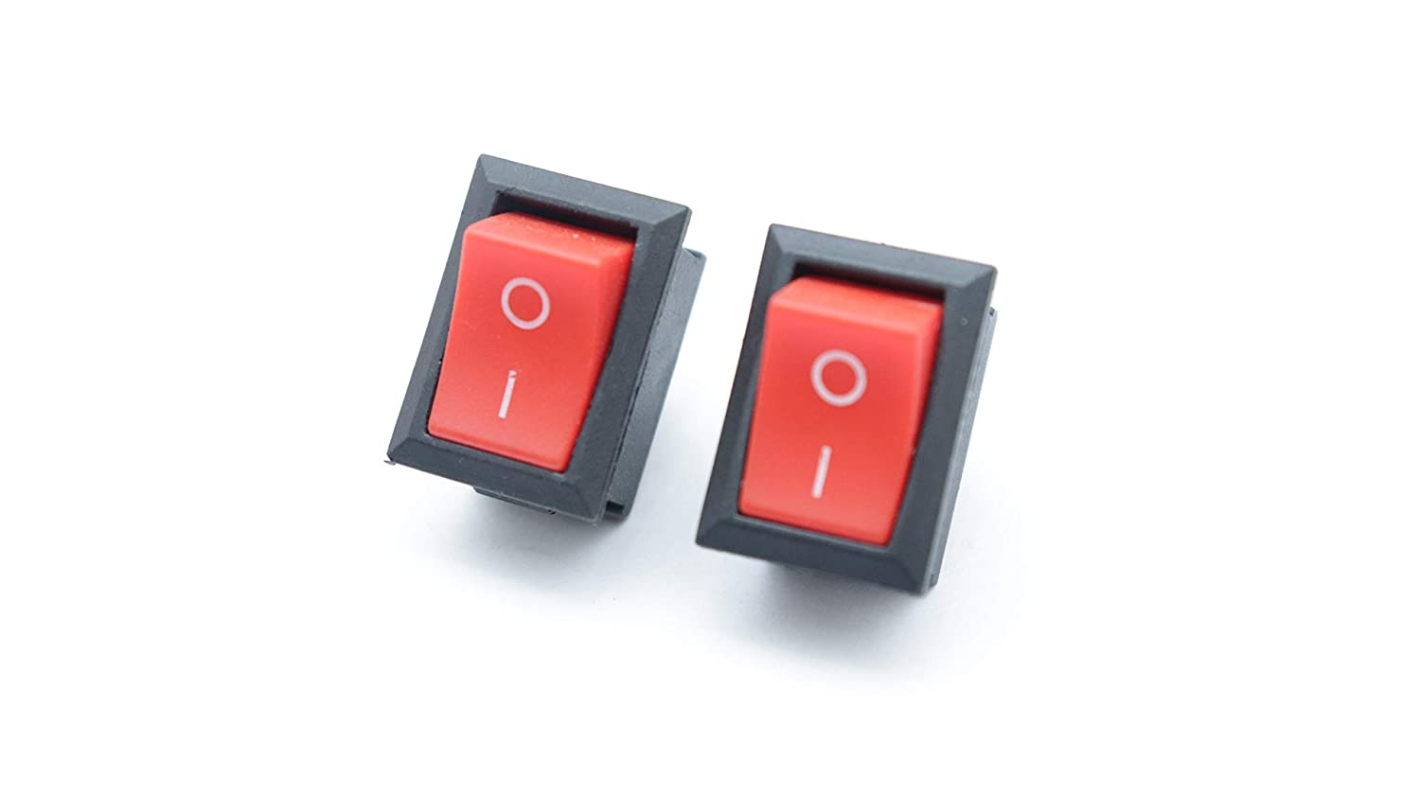
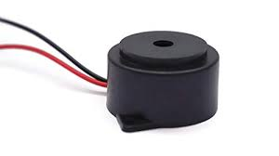
Buzzer : The Piezoelectric sound modules work on the concept of conversion using natural piezoelectric ceramic oscillation
Switch : an electrical component that can disconnect or connect the conducting path.

Slide 9
WORKING :
Connect the IR sensor to the arduino with the jumper wires. Now dump the code into Arduino using USB cable Connect USB cable to pc and open arduino software, enter the code and compile & run then select the arduino port and click upload button then your code will be uploaded into arduino. Now connect the batteries and check the output of eye blink sensor. If there is a blink of eye there will be buzzer sound . The proposed work is completely illustrated

Slide 10
Weakness:
The condition like microsleeping in straight highways cannot be detected.
The driving style of the current driver needs to be learned.
Strength:
Saves lives
Non-invasive in nature
SWOT ANALYSIS
OPPURTUNITY:
This works best for the patients admitted in the hospital suffering with coma
THREATS:
Damage of Circuit leads to Short Circuit.
Should be kept away from little kids.

Slide 11
Applications:
It can be used to keep a check on the driver and make sure he/she is not drowsy. This can help avoid a lot of accidents
It can be used to count the blinking of a person
It can be used to know when a patient is awake or conscious.

Slide 12
OUTPUT PRODUCT

Slide 13
CONCLUSION
People are increasingly exposed to dangers today. Therefore, we need to take action against this as an engineer and have the solution we need. Any automation is designed to protect a person. Such a model is tasked with developing a system for diagnosing and controlling the speed of vehicles to prevent accidents. To some extent, modern technology offers some hope of stopping these. This paper includes monitoring the blink of an eye with the help of an IR sensor.

Slide 14


